Slide 1




Modeling of Helicobacter Pylori

Slide 2
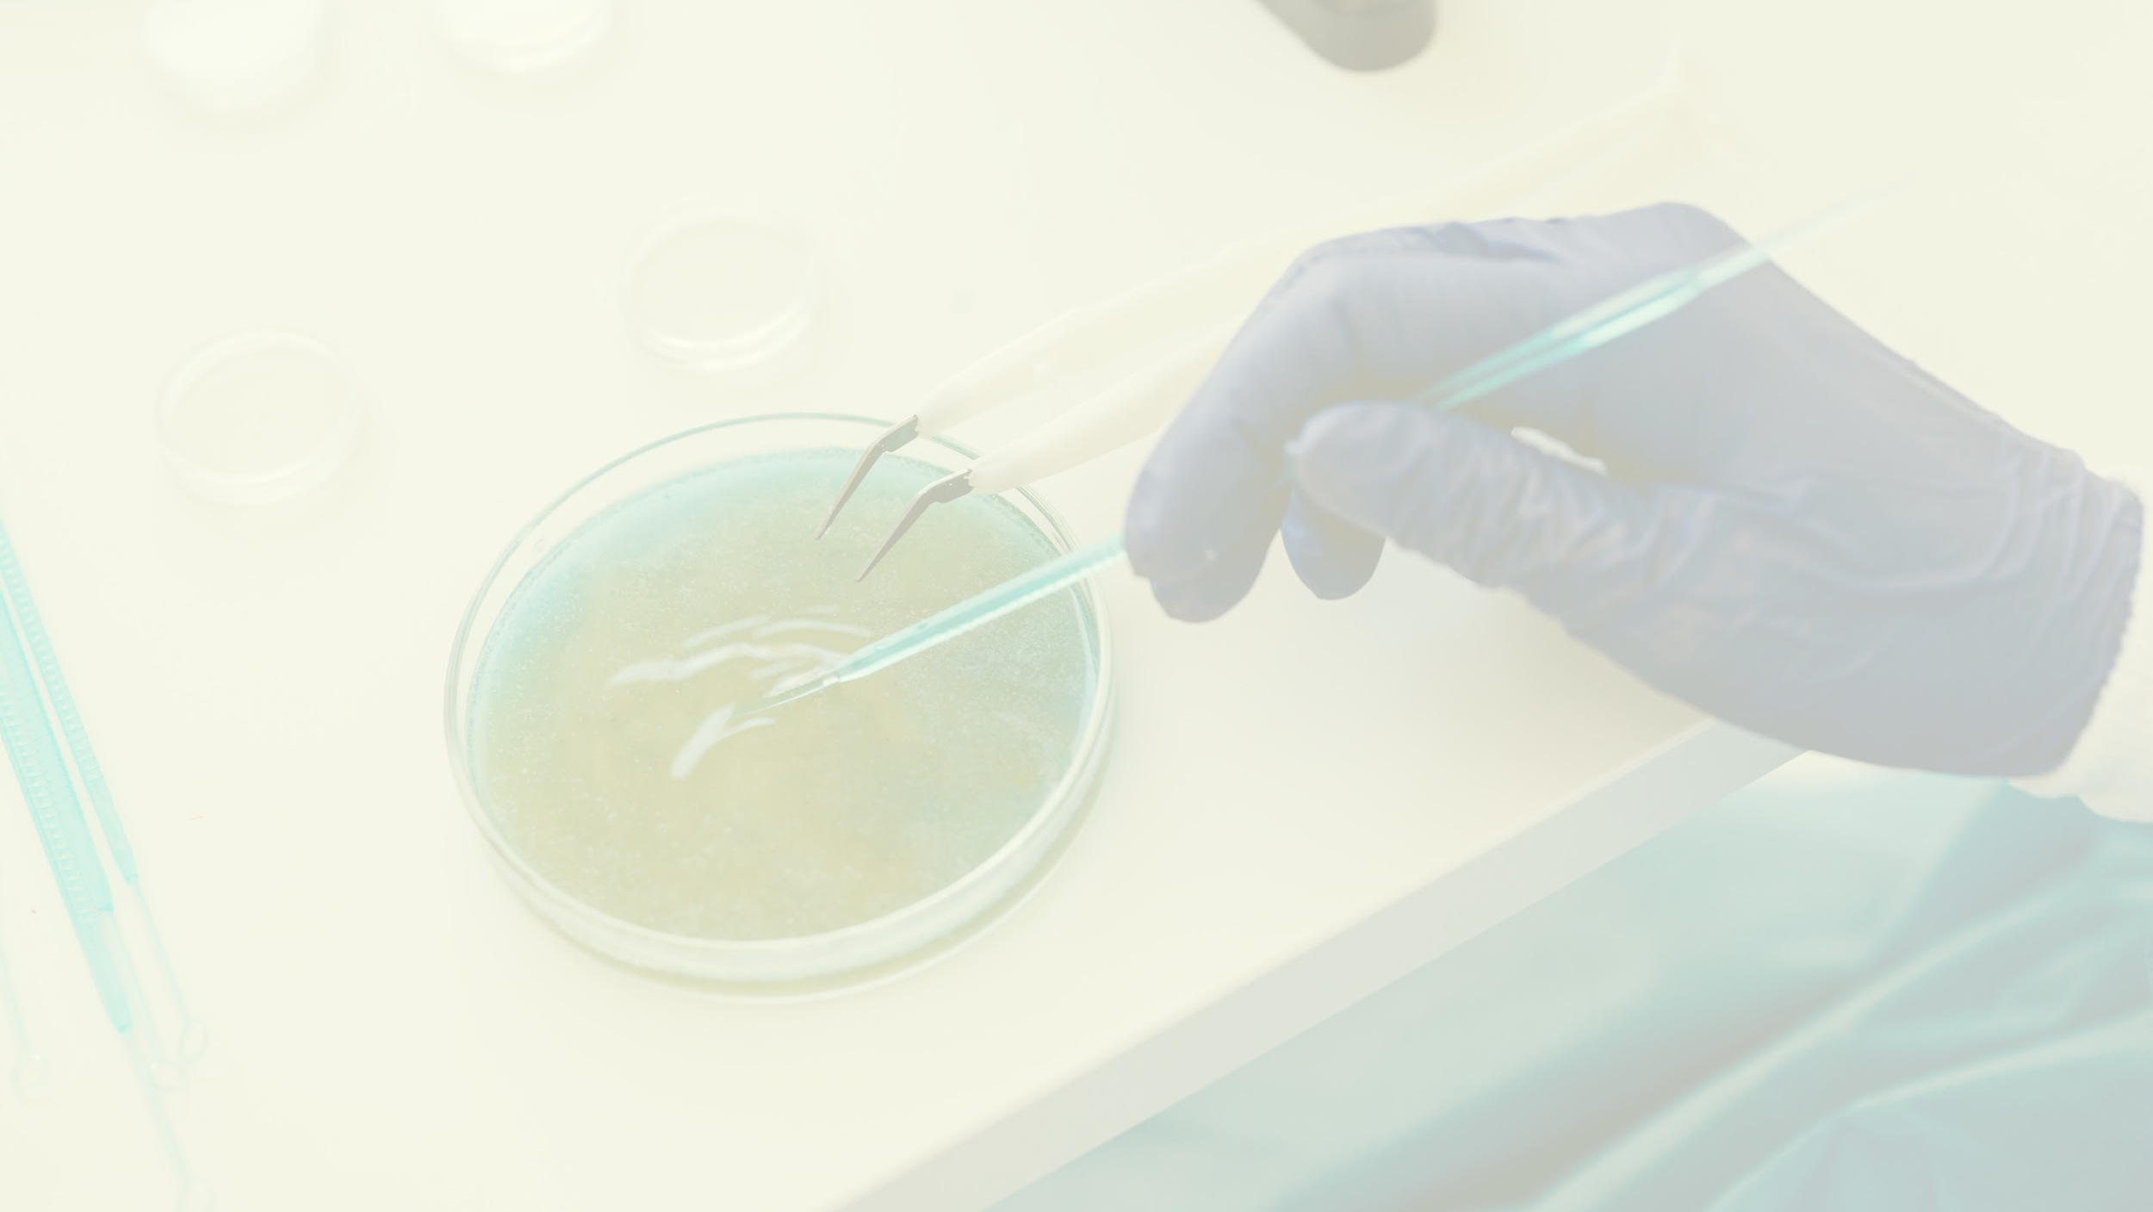

Our Team
Maha Mahmoud Mohammed
Group 4, Section 2
(Team Leader)
Khloud Farouk Fouad
Group 2, Section 1
(Team member)
Nourhan Mohamed Ali
Group 4, Section 3
(Team member)
Hend Khaled Lotfy
Group 4, Section 4
(Team member)
Hala Khaled Mohamed
Group 4, Section 4
(Team member)
Salma Ahmed Nady
Group 2, Section 3
(Team member)

Slide 3
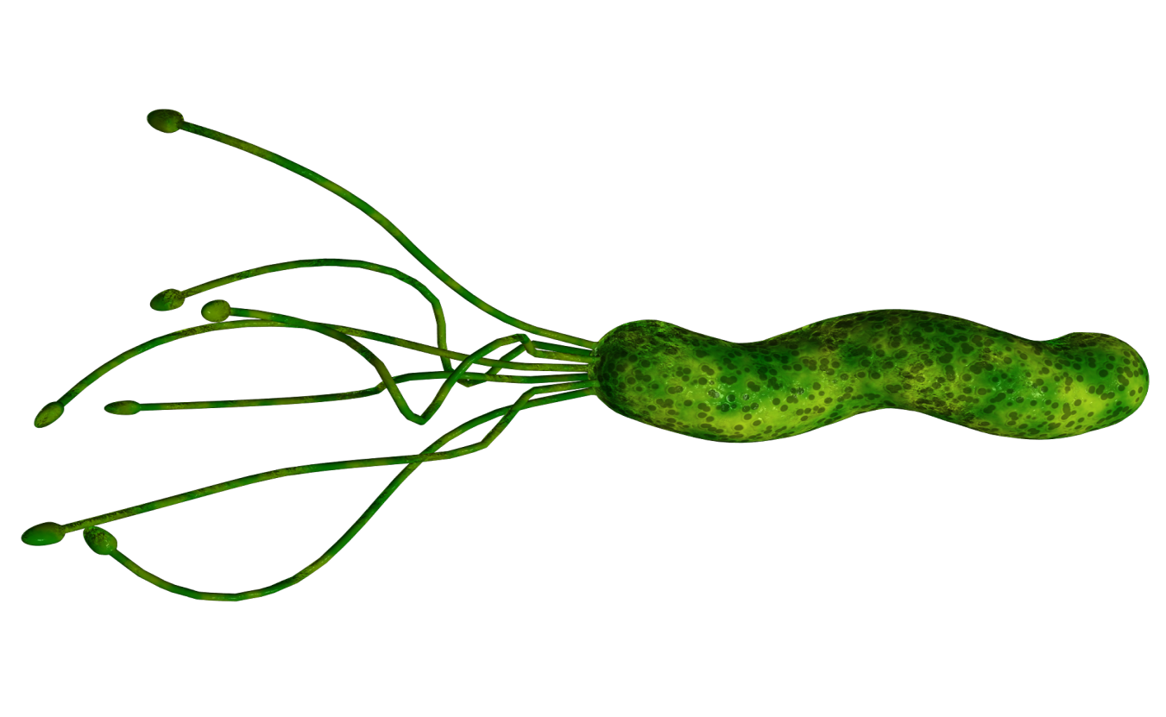
TABLE OF CONTENTS
01
02
03
The Goal of our project
Introduction
Steps of project
04
05
Technologies used to make the model
Importance of H.Pylori model

Slide 4
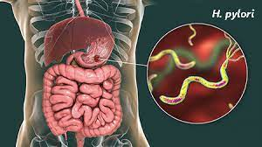
First Section
Introduction to Helicobacter pylori

Slide 5
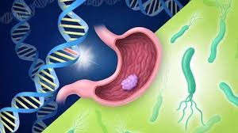
Introduction
Pylori causes a strong systemic immune response, creating a chronically inflamed environment with reduced stomach acidity that favors the growth of other bacteria in the gastric environment, maintaining the inflammation and thereby reducing the level of vitamin C in the gastric juice.

Slide 6
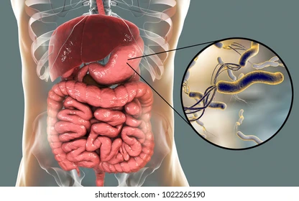
Second Section
The Goal of our project

Slide 7

The Goal of our project
Our project is about making a model of Helicobacter pylori to answer the question: How many strains can there be in Helicobacter pylori ? How many species are there in Helicobacter pylori ? Is there a difference between them or not?
How to create a reaction for H.Pylori? To answer these questions, we will create a Helicobacter pylori model using the following steps:

Slide 8
Steps for making a Helicobacter pylori model

Slide 9
Flowchart of our bacteria modeling
https://drive.google.com/file/d/1wyMW_Q7nmVQUM7MCdMb7O-GQjmWhAjt6/view?usp=sharing
https://lucid.app/lucidchart/7448a0ba-bedb-46d9-b452-3dda749ddb2d/edit?invitationId=inv_aa3a977c-c7ce-44a7-8e13-820dbefeb045

Slide 10
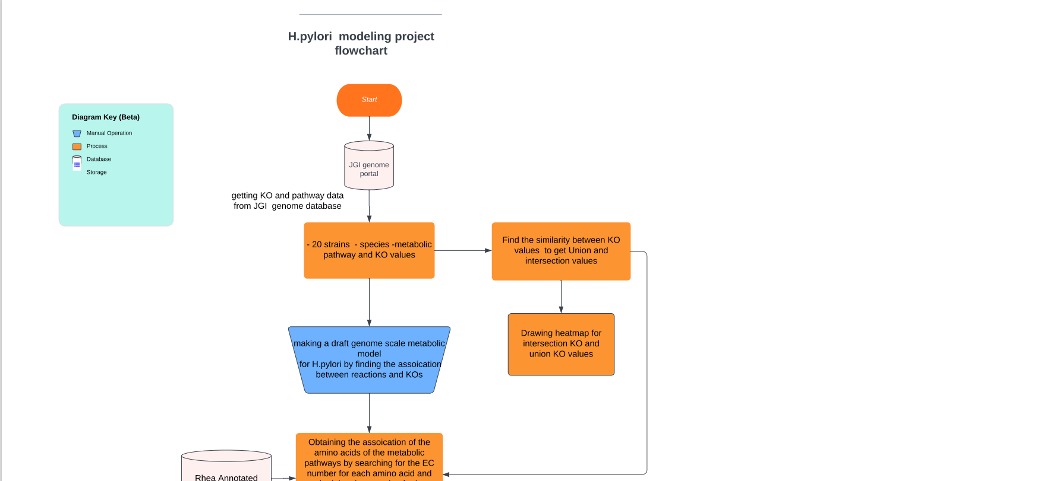

Slide 11
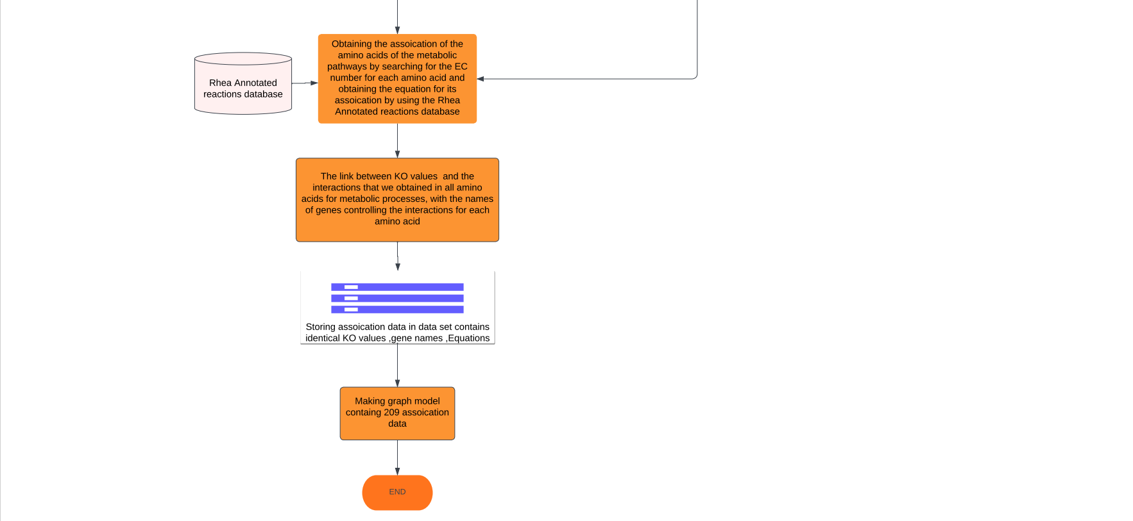

Slide 12
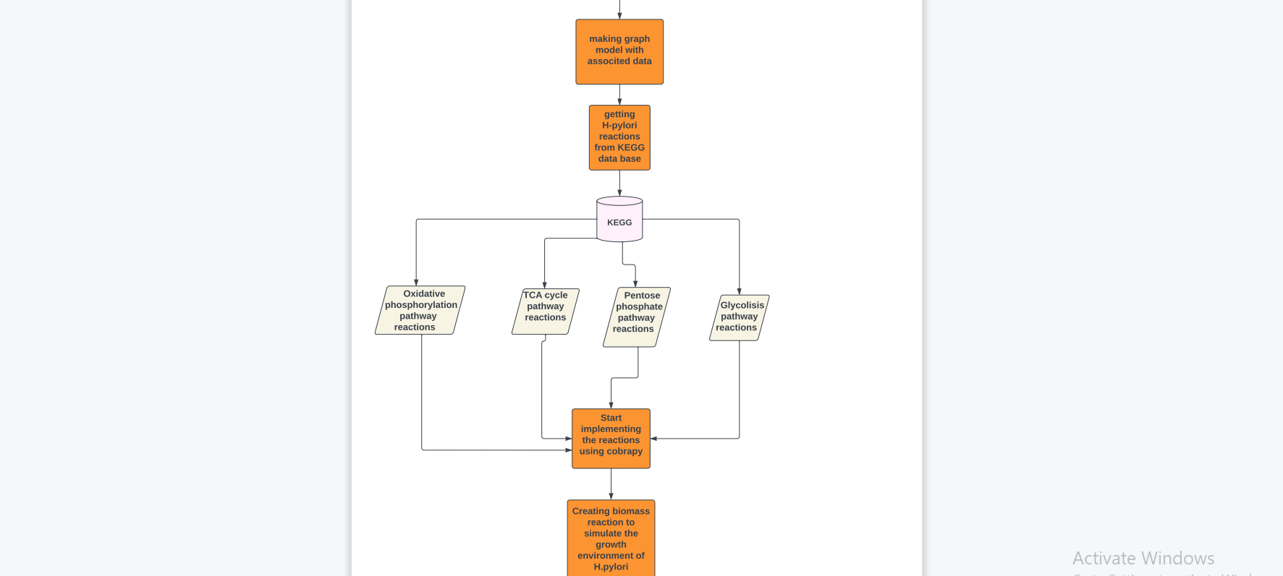

Slide 13


Slide 14
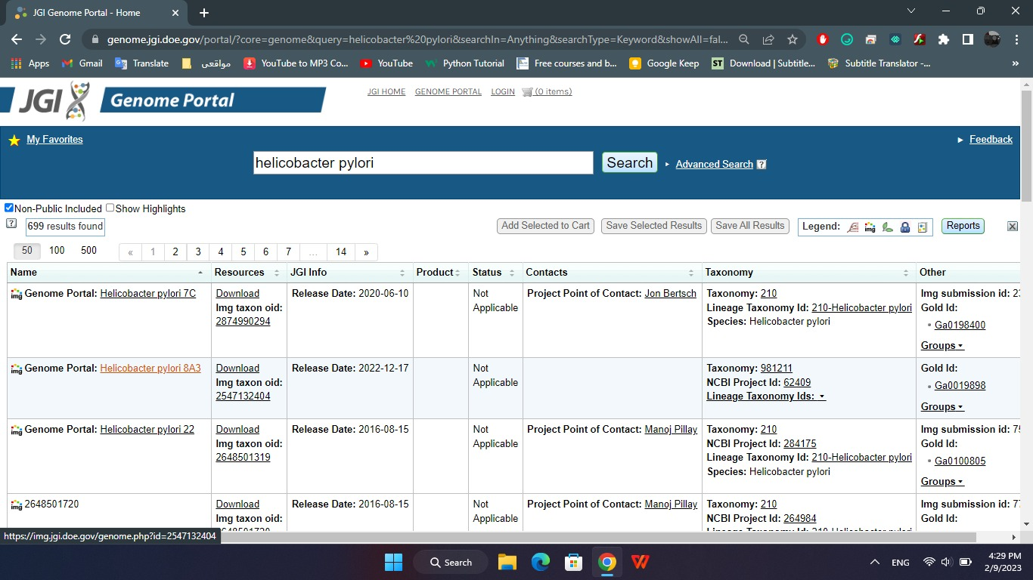
First, search for the name of the bacteria we chose in the JGI database

Slide 15
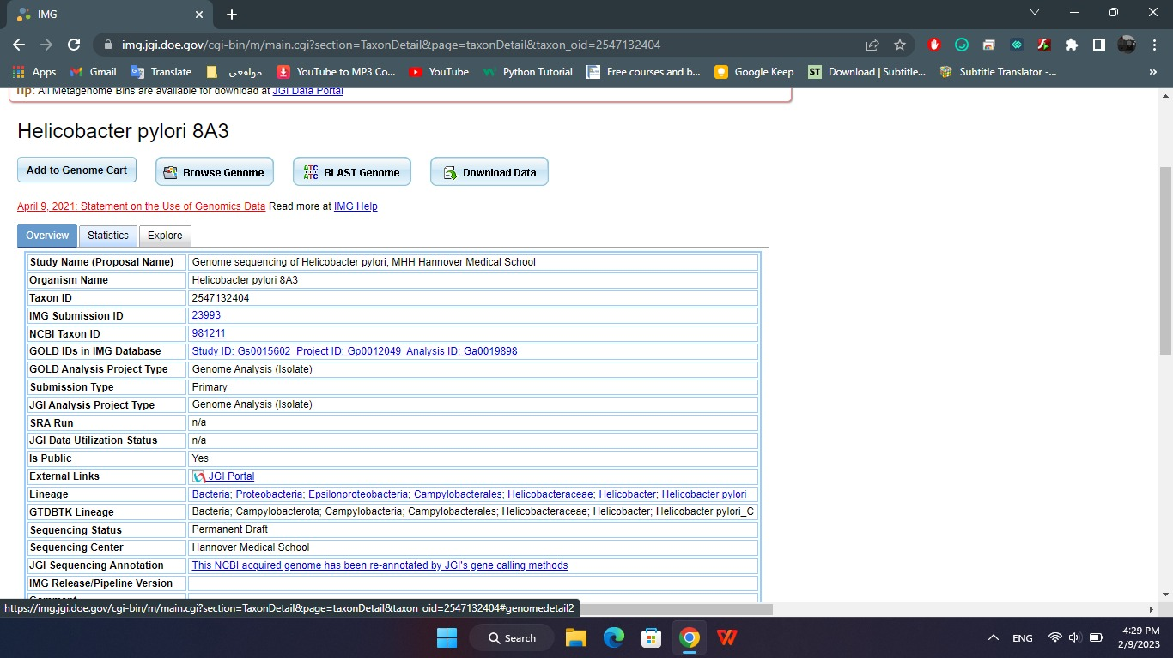
Select one of the bacteria genome portal and open the statistics for that genome portal

Slide 16
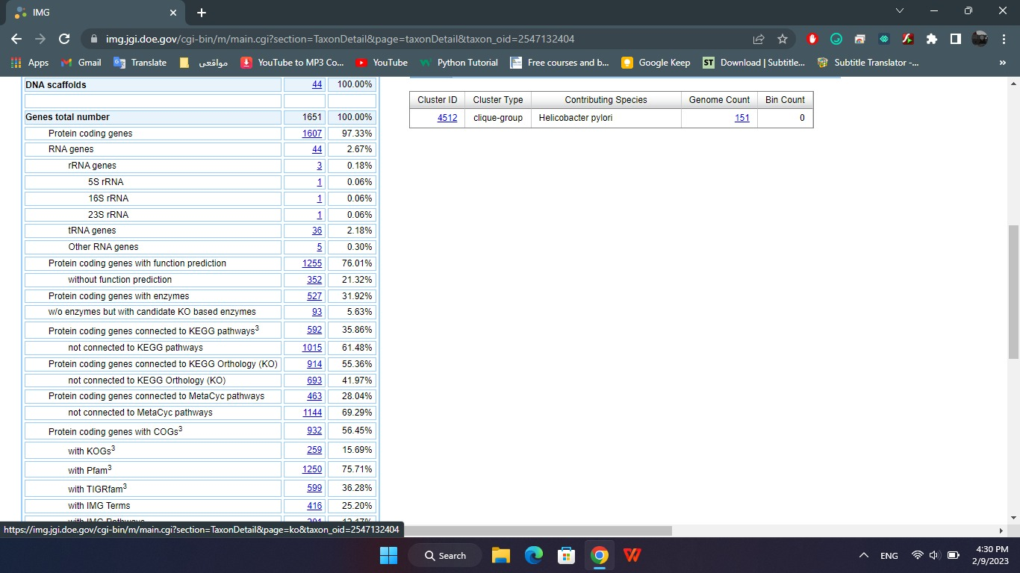
Identification of protein-coding genes related to KEGG Orthology (KO)

Slide 17
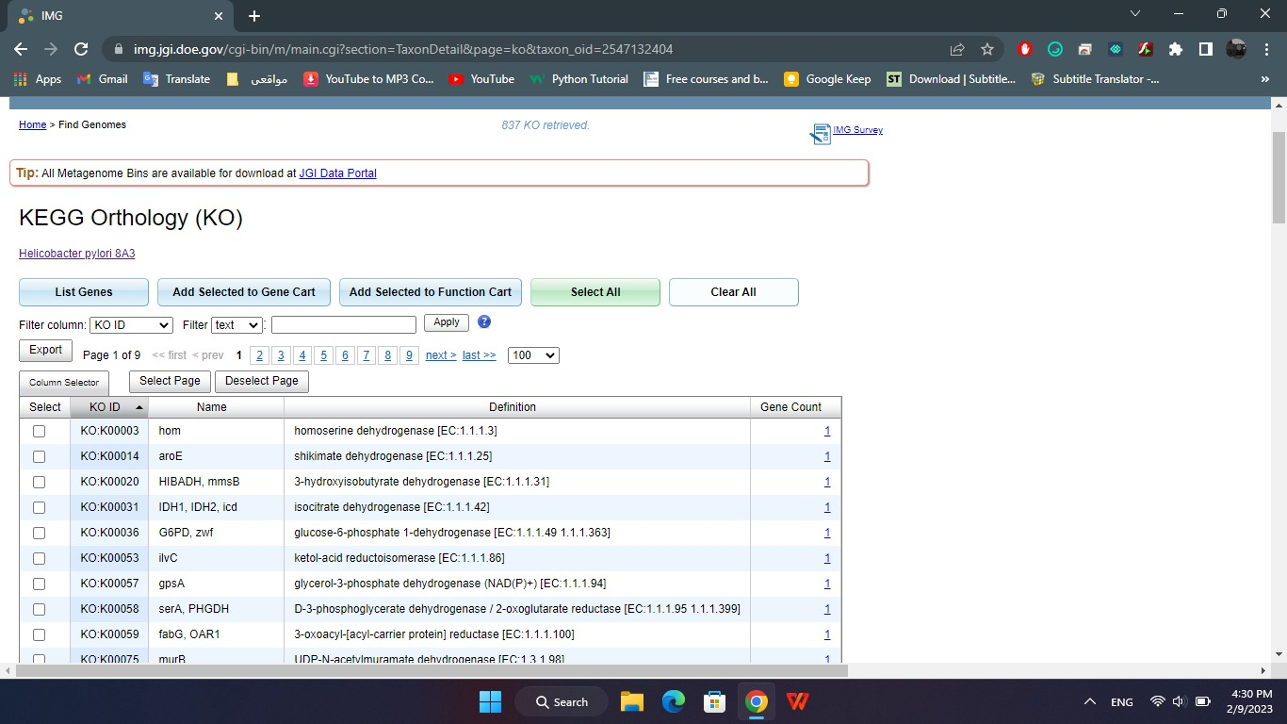
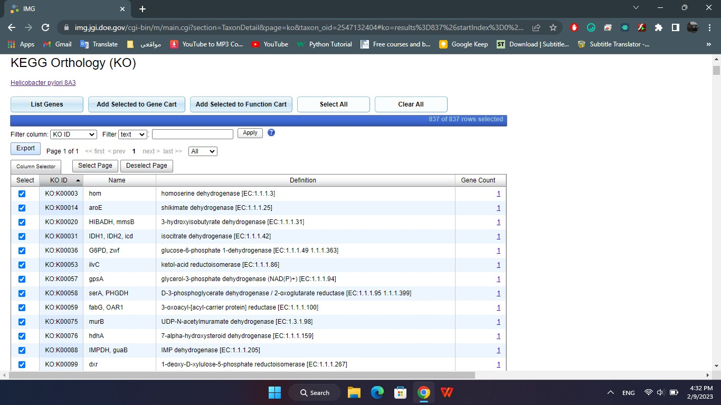
A window with KO information such as name, definition and number of genes appears, we select all cells to download

Slide 18

Then, Find the similarity between KO values to get Union and intersection values.
Similarity between the KO values and the union and intersection files https://github.com/mahamahmoud25715/Helicobacter-pylori/find/main

Slide 19
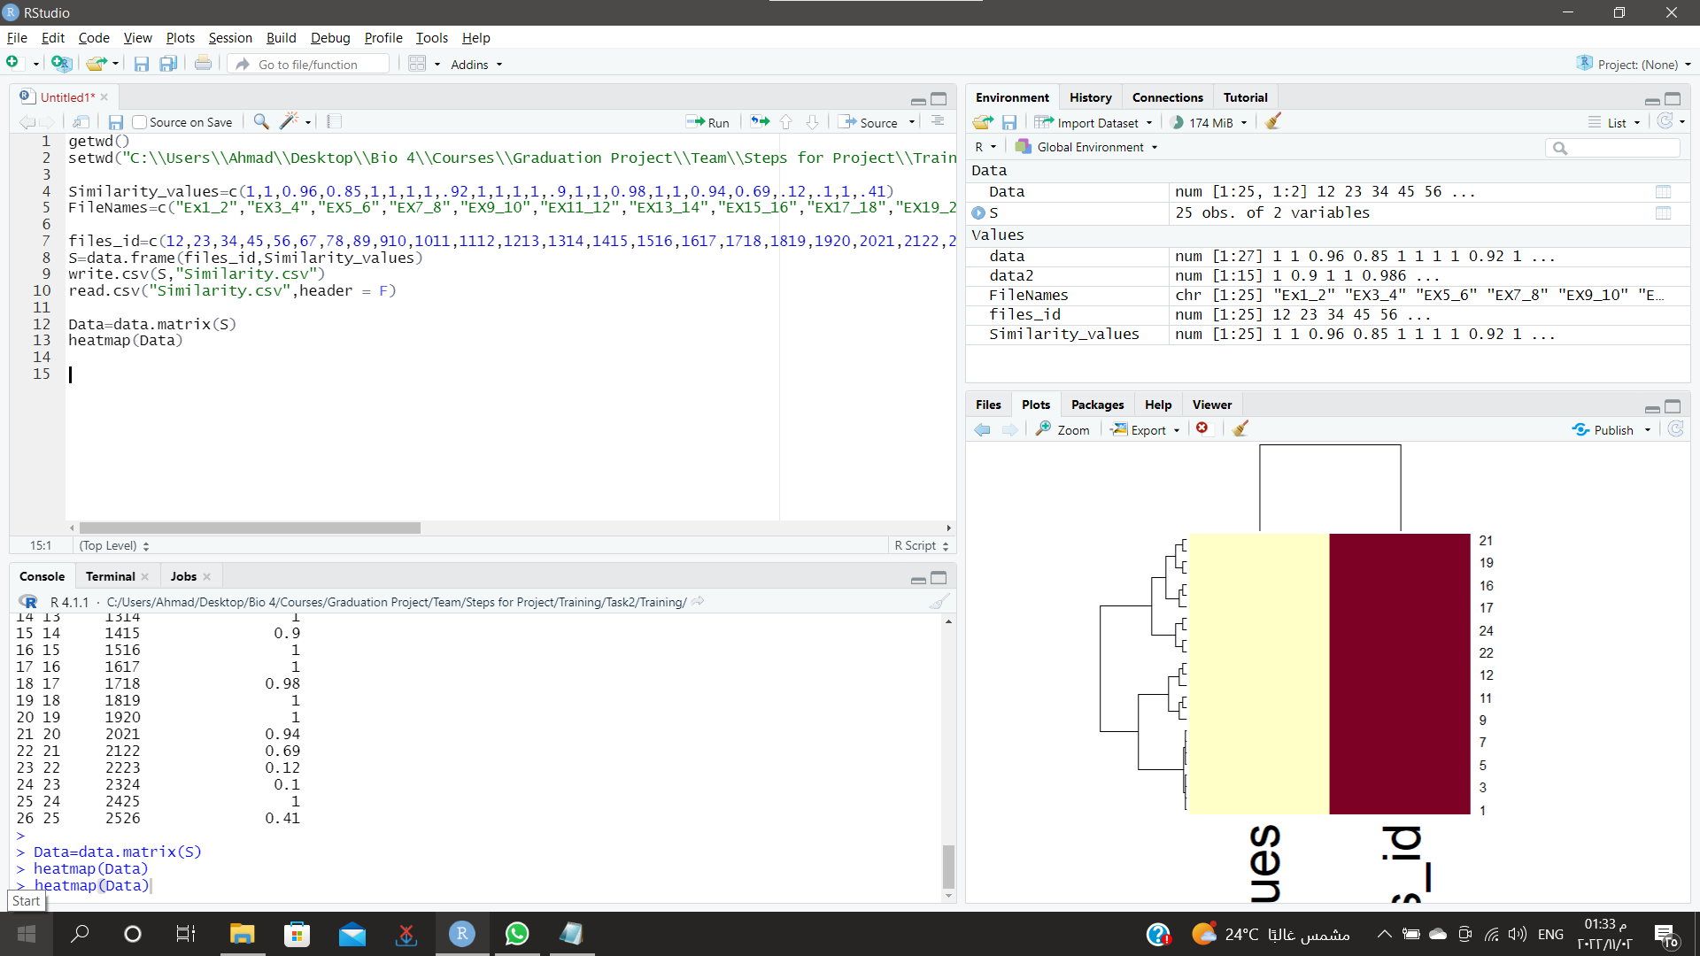
Next, Drawing heatmap for intersection KO and union KO values.

Slide 20
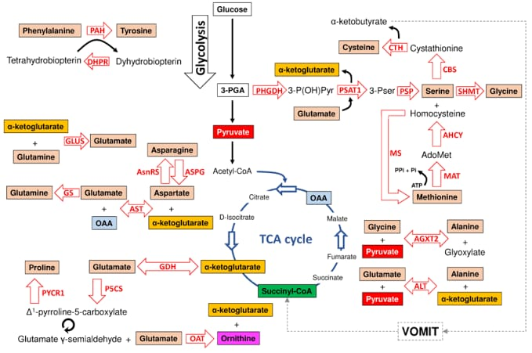
After that, making a draft genome scale metabolic model for H.Pylori by finding the association between reactions and Kos.

Slide 21
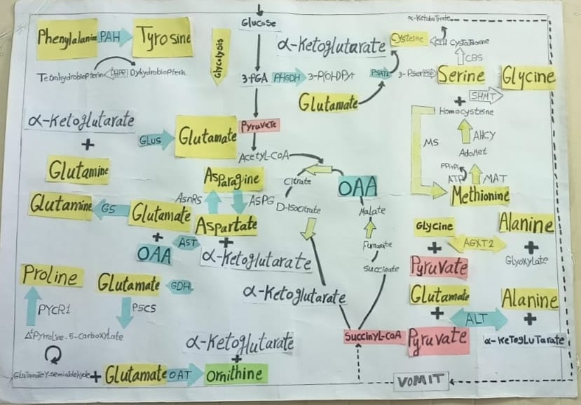

Slide 22
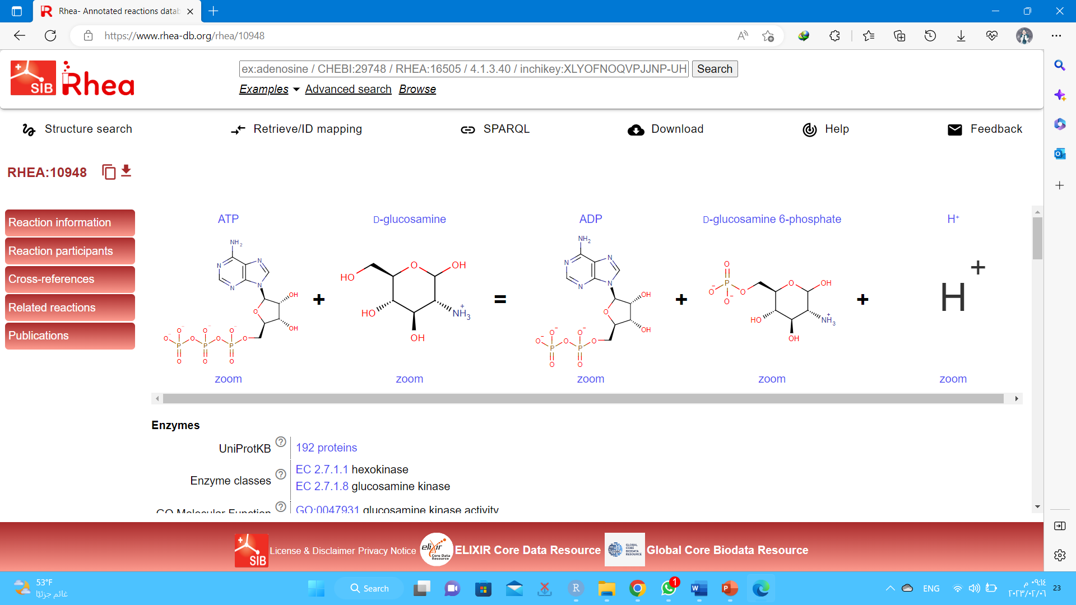
Obtaining the association of the amino acids of the metabolic pathways by searching for the EC number for each amino acid and obtaining the equation for its association by using the Rhea Annotated reactions database.

Slide 23
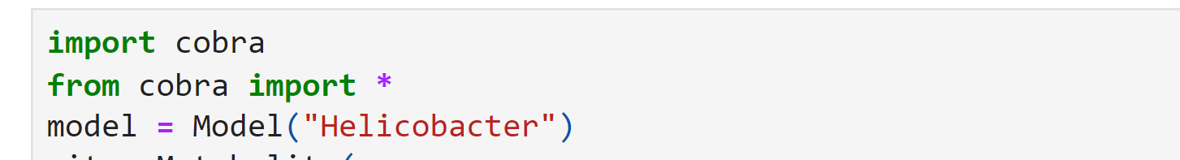
Cobra is a Python package to build predictive models using linear or logistic regression with a focus on performance and interpretation. It consists of several modules for data preprocessing, feature selection and model evaluation
CopraPY is an object-oriented framework designed to meet the computational challenges associated with the next generation of stoichiometric constraint-based models and high-density omics data

Slide 24
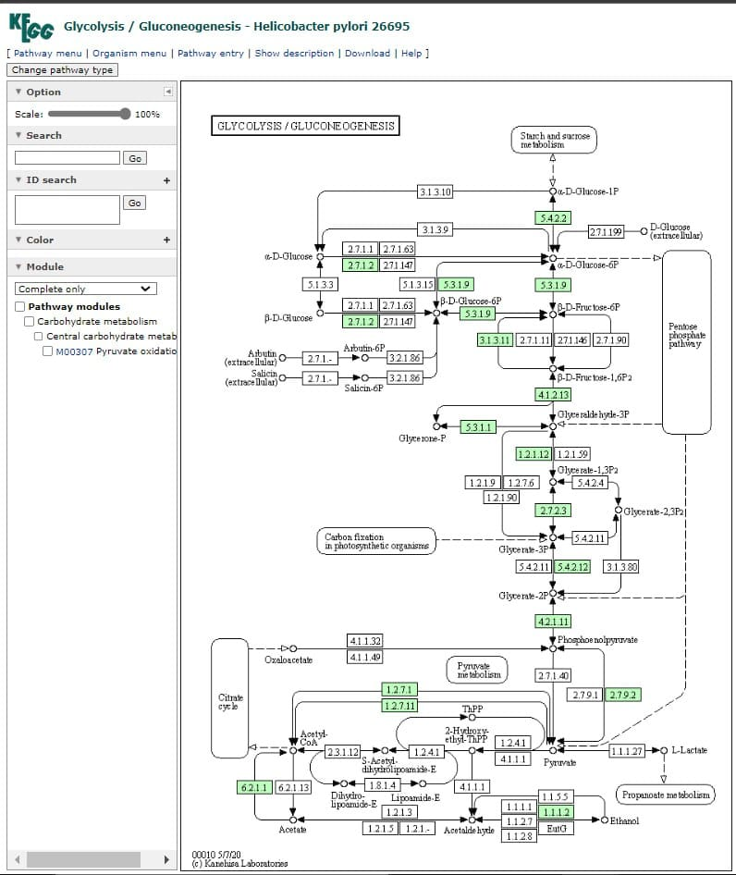
(1) Glycolysis Pathway
Glycolysis Pathway Input: Glucose Output: 2 pyruvate 2 ATP 2 NADH 2 H+

Slide 25
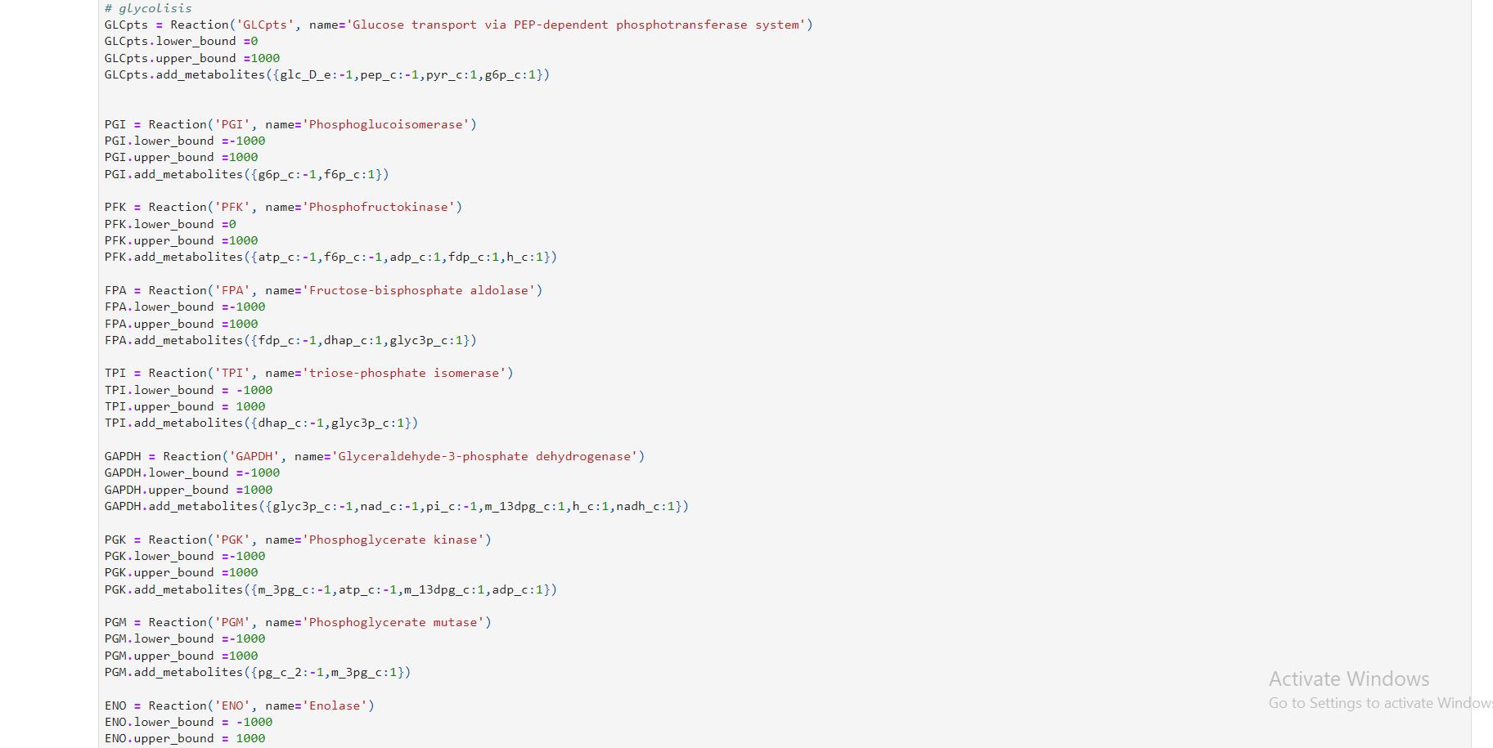

Slide 26
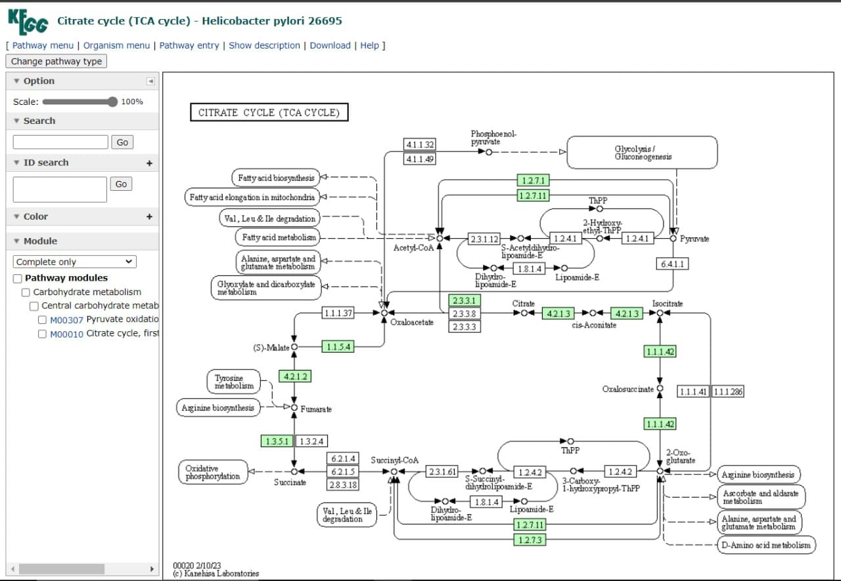
(2) TCA Cycle Pathway
TCA Cycle Pathway Input: Acetyl-CoA NAD+ FAD ADP Output: 3 NADH 1 FADH2 1 ATP 2 CO2

Slide 27


Slide 28
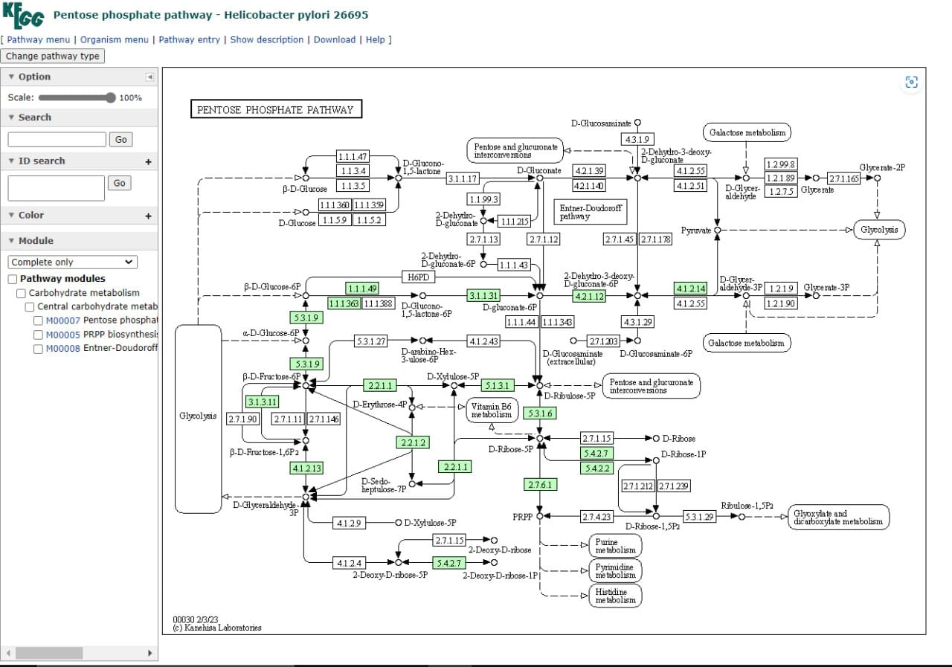
(3) Pentose Phosphate Pathway
Pentose Phosphate Pathway Input: Glucose-6-phosphate Output: NADPH Ribose-5-phosphate

Slide 29


Slide 30
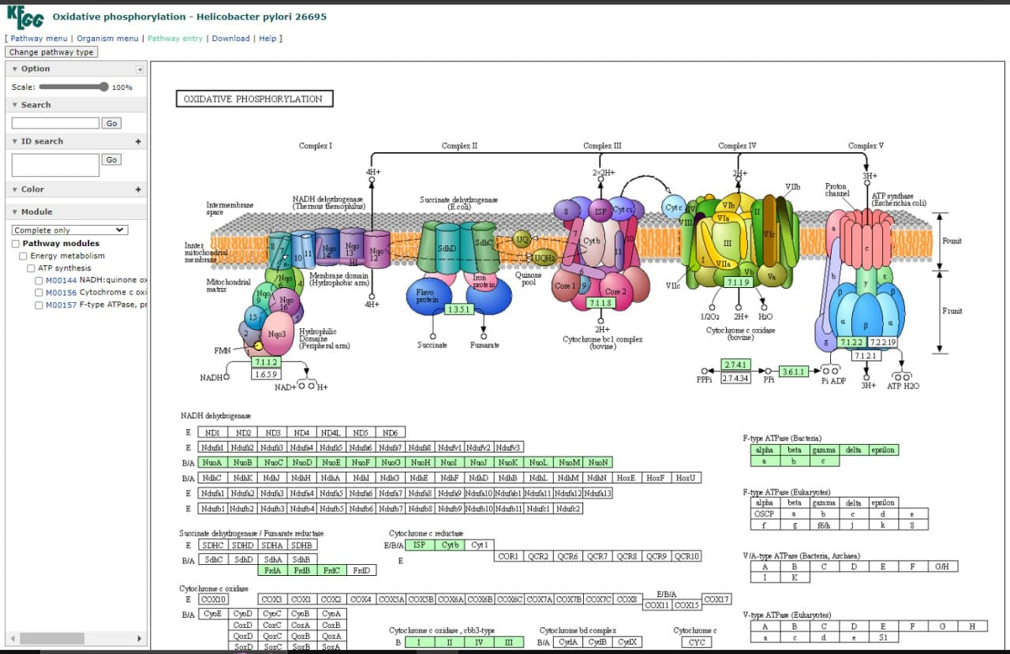
(4) Oxidative Phosphorylation Pathway
Oxidative Phosphorylation Pathway Input: NADH FADH2 O2 ADP Pi Output: ATP H2O NAD+ FAD+

Slide 31


Slide 32
Does the H.Pylori media need an amino acid or not?
Yes, Helicobacter pylori requires amino acids for growth, as it is an auxotrophic bacterium. This means that it cannot synthesize certain essential amino acids and must obtain them from its environment. Studies have shown that Helicobacter pylori requires several amino acids for growth, including arginine, cysteine, glutamate, histidine, isoleucine, leucine, methionine, phenylalanine, proline, serine, threonine, tryptophan, tyrosine, and valine. The specific requirements for each amino acid may vary depending on the strain and growth conditions. In addition to amino acids, Helicobacter pylori also requires other nutrients for growth, such as vitamins, minerals, and carbohydrates. These nutrients are obtained through the breakdown of host tissue and the uptake of nutrients from the gastric mucosa. Understanding the nutrient requirements of Helicobacter pylori is important for developing effective treatments and interventions for the bacterium.

Slide 33
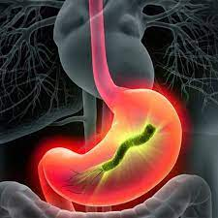
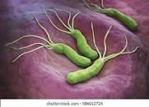

Illustration of some examples of Helicobacter pylori

Slide 34
Biomass
Biomass reflects the distribution of both energy and materials in the community. Plant biomass absorbs carbon dioxide during growth and emits it during combustion; therefore, it recycles atmospheric carbon
of one animal or plant species (species biomass) or of all the species in a community (community biomass), commonly referred to a unit area or volume of habitat. The weight or quantity of organisms in an area at a given moment is the standing crop

Slide 35
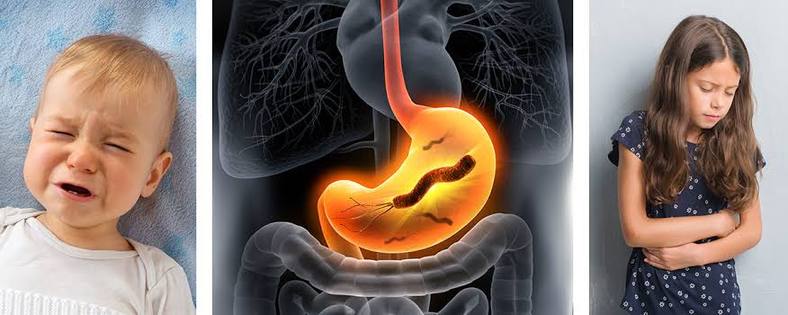
Biomass has many benefits, the primary one being that it cannot be depleted like fossil fuels. With an abundance of plants on Earth, biomass could be a primary source of renewable energy that's used as a sustainable alternative to fossil fuels
Import of Biomass

Slide 36


Slide 37
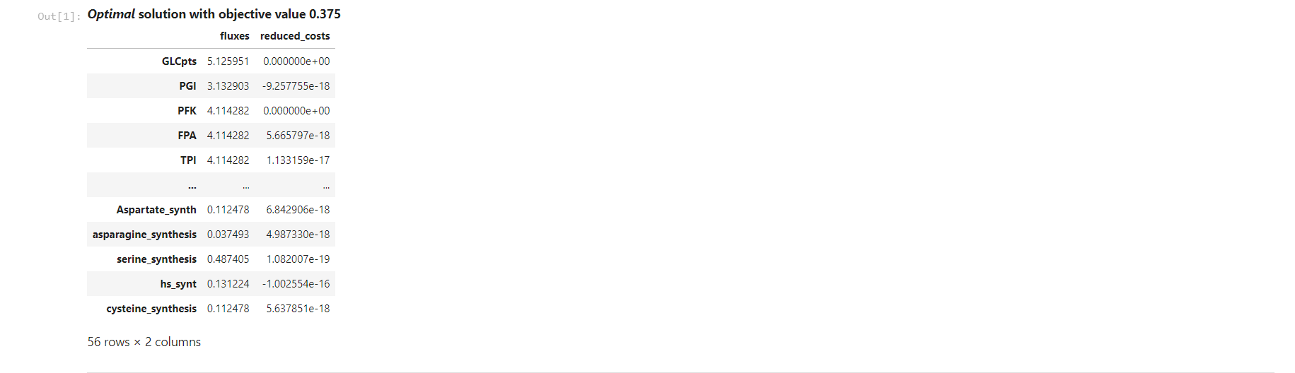
Final Output

Slide 38
Importance of H.Pylori model

Slide 39
Making a model for H. pylori bacteria helps us to enhance scientific and medical research specifically about it and discover its functions through the model, and through it we can also determine the mechanism of its work in and know the diseases that it can cause inside the body, as it will also determine for us its complete classification to know its characteristics and nature.
Importance of H.Pylori model
The bacterial model can determine for us the strategy that describes the behavior of bacteria and through it we can know the conditions that suit the growth and spread of bacteria.

Slide 40
Technologies used to make the model

Slide 41
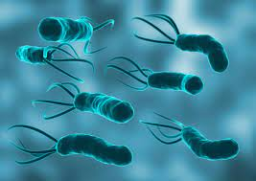
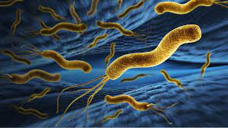
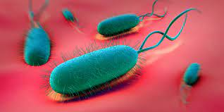
Json is perfect for storing temporary data. For example, temporary data can be user-generated data, such as a submitted form on a website. JSON can also be used as a data format for any programming language to provide a high level of interoperability
JSON stands for JavaScript Object Notation
JSON is a lightweight format for storing and transporting data
JSON is often used when data is sent from a server to a web page
JSON is "self-describing" and easy to understand
Escher is a web-based tool for building, viewing, and sharing visualizations of biological pathways. These pathway maps are a great way to contextualize data about metabolism.
Json & Escher

Slide 42
Modeling of Helicobacter Pylori

Slide 43
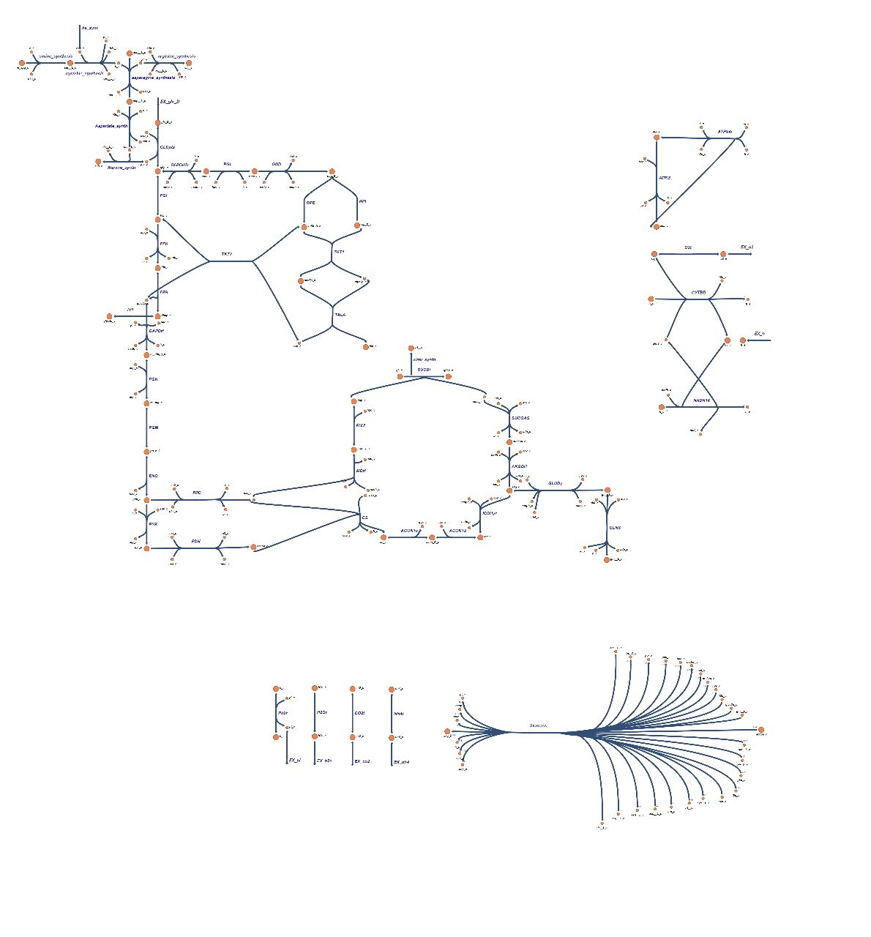

Slide 44
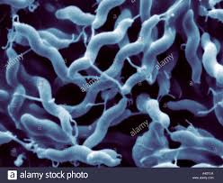
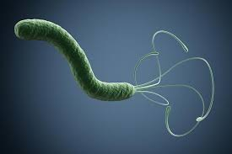
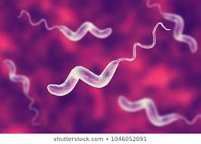
Pylori
References
Characteristics of Helicobacter pylori growth in a defined medium and determination of its amino acid requirements https://pubmed.ncbi.nlm.nih.gov/8000535/
Growth Supplements for Helicobacter pylorihttps://www.ncbi.nlm.nih.gov/pmc/articles/PMC86644/
Helicobacter
H.Pylori

Slide 45



THANK YOU!
For your listening

Slide 46
GET IN TOUCH
Email
Maha.20367810@compit.aun.edu.eg
Hind.20367841@compit.aun.edu.eg
Nourhanne.20367835@compit.aun.edu.eg
khloud.20367653@compit.aun.edu.eg
hala.20367838@compit.aun.edu.eg
salma.20367693@compit.aun.edu

